Slide 1


HR Helping Hand: The Employee Attrition AND PERFORMANCE ANALYSIS

Slide 2

Table Of Content
Introduction
Literature Survey
Objective of Our Project
Dataset and Parameters
Proposed Model
Algorithms to be Used
References

Slide 3

Introduction
HR estimates the requirement of human resources in each part of organization and plan to recruit talented people, placing each employee’s progression, employee’s retention, attrition, salaries and other welfare benefits. Employees are the treasured property of any organization. However, if you quit your job unexpectedly, the company will cost a lot of money. Not only new employees are wasting money and time, but new employees are also spending time making profits for their companies.

Slide 4
IT companies — Tata Consultancy Services (TCS), Infosys, Wipro and HCL Tech, among others — are facing high attrition rates and the IT sector’s average attrition rate (last twelve months) is currently as high as 25 per cent.
This data is driven from an article published on news18.com
By Mohammad Haris
30
25
20
15
10
5
0
Infosys HCL Tech Wipro TCS

Slide 5
Litrature Survey
Paper[1] SindiFatika Sari, Kemas Muslim Lhaksmana. Employee Attrition Predition Using Feature Selection with information Gain and Random Forest Classification.
This research aims to help the human resources department in the company to find out what factors influence the employee attrition, by developing a new method of predicting attrition that this study aims to detect employee attrition in a company by implementing the Random Forest classification modeling. From the results of the tests that have been carried out, Information Gain produces the highest accuracy value of 89.2%, while Select K Best produces an accuracy value of 87.8% and Recursive Feature Elimination produces an accuracy value of 88.8%
Paper[2] Elham Mohammed Thabit A. Alsaadi; SameerahFarisKhlebus, AshwakAlabaichi. Idenification of
humanresourse analytics using machine learning algorithms.
To find the probability of new employee attrition, various classification algorithms such as decision trees (DT) classifier, logistic regression (LR), random forests (RF), and K-means clustering are used. The accuracy provided by the decision tree is 97% the accuracy provided by random forest algorithm is 98% the accuracy provided by the logistic regression is 78%. This research aims to identify the most critical elements that contribute to employee attrition. Used ML algorithms for binomial classification problem are: decision trees, logistic regression, and random forest
Paper[3] Vinston Raja R; Srinath Doss; Ashok Kumar K. Analytics Approach of predicting Employee Attrition using data science techniques.
The usage of NB algorithm, KNN algorithm and SVM algorithm, prediction supply the end result of which algorithm is performing better. Naive Bayesian algorithms, K-nearest neighbors, and support vector machine data science techniques were applied to the predictions. Naive Bayes Algorithm predicted the developer turnover with the accuracy of 76%, K-Nearest Neighbor with the accuracy of 94% and Support Vector Machine with the accuracy of 96%

Slide 6
Paper[4] EvanthiaFaliagka, Kostas Ramantas, Athanasios Tsakalidis Application of Machine Learning Algorithms to an online Recruitment System.
there is using of various algorithms which are Gaussian Naïve Bayes Classifier, Decision Tree, Logistic Regression and Model tested on IBM analysis dataset best recall rate (0.54).It helps in HR activities optimizes and reduce critical issues by analyzing of data. The Techniques used for better error estimation are Holdout, Cross validation Scaling is used to avoid that one features is dominating
paper[5] Ali A. Mahmoud, Tahini AL Shawabkeh, Walid A. Salameh, Ibrahim Al Amro Performance predicting in hiring process and performance appraisals using machine learning.
we study the concept of employee retention on key variables. Training, types of training and duration and check the effect of training or retention of employee satisfaction leads to employee dissatisfaction leads to high turnover. The objective is to identify the effect of training, its types and duration on retention. Main reason for employee retention are Training time and its duration, Support Interest among employee, workplace environment, Reward.
paper[6] AnanyaSarker, S.M. Shamim, Dr. Md. Shahiduz Zama & Md. Mustafizur Rahman Employee’s Performance Analysis and prediction using K-means Clustering & Decision Tree Algorithm.
we study that most of the organization or companies have a formal performance evaluation system in which employee job performance is graded on a regular basis, usually once or twice a year. An Employee can improve their performance by way of monitoring the progression of their performance by way of Machine learning algorithms i.e. clustering algorithm and decision tree of data mining techniques can be used to find out the key characteristics of future prediction of an organization.

Slide 7
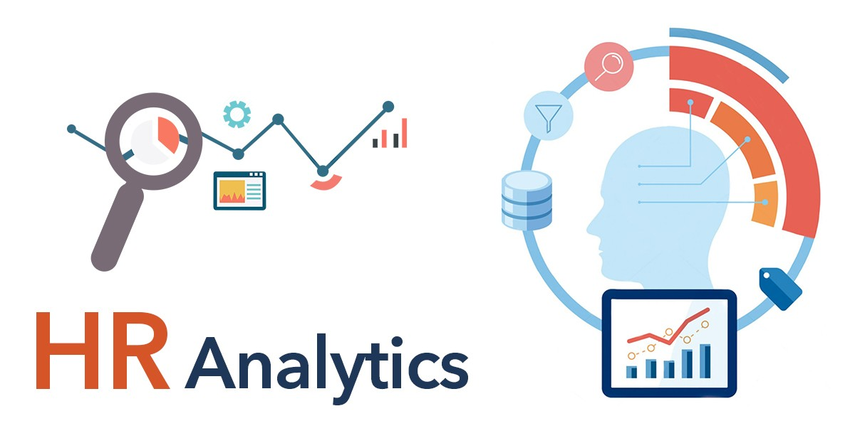
Objective of Our project
HR Analysis tool for companies especially those with large workforce.
To find the possible reasons for employee attrition, in order to prevent valuable employees from leaving.
Predicting employee’s performance rating.

Slide 8
Dataset and parameters
Variable | Meaning | Levels
Age | Age of the employee
Attrition | Whether the employee left in the previous year or not
BusinessTravel | How frequently the employees travelled for business purposes in the last year
Department | Department in company
DistanceFromHome | Distance from home in Kms
Education | Education Level | 1 'Below College'
 |  | 2 'College'
 |  | 3 'Bachelor'
 |  | 4 'Master'
 |  | 5 'Doctor'
EducationField | Field of education
EmployeeCount | Employee count
EmployeeNumber | Employee number/id
EnvironmentSatisfaction | Work Environment Satisfaction Level | 1 'Low'
 |  | 2 'Medium'
 |  | 3 'High'
 |  | 4 'Very High'

Slide 9
Gender | Gender of employee
Job Involvement | Job Involvement Level | 1 'Low'
 |  | 2 'Medium'
 |  | 3 'High'
 |  | 4 'Very High'
JobLevel | Job level at company on a scale of 1 to 5
JobRole | Name of job role in company
JobSatisfaction | Job Satisfaction Level | 1 'Low'
 |  | 2 'Medium'
 |  | 3 'High'
 |  | 4 'Very High'
MaritalStatus | Marital status of the employee
MonthlyIncome | Monthly income in rupees per month
NumCompaniesWorked | Total number of companies the employee has worked for
Over18 | Whether the employee is above 18 years of age or not
PercentSalaryHike | Percent salary hike for last year
PerformanceRating | Performance rating for last year | 1 'Low'
 |  | 2 'Good'
 |  | 3 'Excellent'
 |  | 4 'Outstanding'
RelationshipSatisfaction | Relationship satisfaction level | 1 'Low'
 |  | 2 'Medium'
 |  | 3 'High'
 |  | 4 'Very High'

Slide 10
Standard Hours | Standard hours of work for the employee
Stock Option Level | Stock option level of the employee
Total Working Years | Total number of years the employee has worked so far
TrainingTimesLastYear | Number of times training was conducted for this employee last year
WorkLifeBalance | Work life balance level | 1 'Bad'
 |  | 2 'Good'
 |  | 3 'Better'
 |  | 4 'Best'
YearsAtCompany | Total number of years spent at the company by the employee
YearsSinceLastPromotion | Number of years since last promotion
YearsWithCurrManager | Number of years under current manager

Slide 11
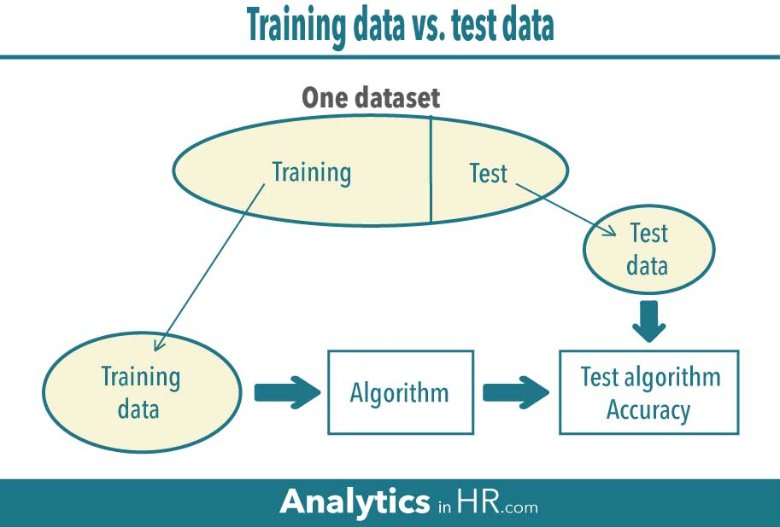

Broad Idea of Model
Working

Slide 12


Proposed Model
Data Cleaning
and
Data Custering
Features used for Attrition
Features used for
Performance analysis
Apply various Machine Learning
Algorithm
Predict attrition of employee
Analyze the performance of employee
Calulate the accuracy score

Slide 13

AlGORITHM TO BE USED
For Attrition Prediction
Decision Tree
Random Forest
Logistic Regression
SVM
For Performance Analysis
K-mean clustering
hierarchical Clustering

Slide 14
REFERENCES
[1].Sindi Fatika Sari, Kemas Muslim Lhaksmana. Employee Attrition Predition Using Feature Selection
with information Gain and Random Forest Classification.
[2].Elham Mohammed Thabit A. Alsaadi; Sameerah Faris Khlebus, Ashwak Alabaichi. Idenification of
human resourse analytics using machine learning algorithms.
[3].Vinston Raja R; Srinath Doss; Ashok Kumar K. Analytics Approach of predicting Employee Attrition
using data science techniques.
[4].Evanthia Faliagka, Kostas Ramantas, Athanasios Tsakalidis Application of Machine Learning Algorithms to an online Recruitment System.
[5].Ali A. Mahmoud, Tahini AL Shawabkeh, Walid A. Salameh, Ibrahim Al Amro Performance predicting in hiring process and performance appraisals using machine learning.
[6].Ananya Sarker, S.M. Shamim, Dr. Md. Shahiduz Zama & Md. Mustafizur Rahman Employee’s Performance Analysis and prediction using K-means Clustering & Decision Tree Algorithm.

Slide 15
[7].Francesca Fallucchi, Marco Coladangelo, Romeo Giuliano and Ernesto William De Luca. Predicting Attrition Using Machine Learning Techniques.
[8].Sarah S. Alduayj, Kashif Rajpoot Predicting Employee Attrition Using Machine Learning.
[9].Jozsef Pap, Csaba Mako, Miklos Illessy, Zef Dedaj, Sina Ardadili, Bernat Torok and Amir Mosavi.
Correlation Analysis of Factors Affecting Firm Performance and Employees Wellbeing: Application of Advanced Machine Learning Anaysis.
[10]. Batta Mahesh. Machine Learning Algorithms – A Review.

Slide 16



Team Presentation
Rohit Sharma
CSE-Department
Nishant Kumar CSE-Department
Mohd. Shahjahan CSE-Department

Slide 17


Thank you
Bring the attention of your audience

